Slide 1
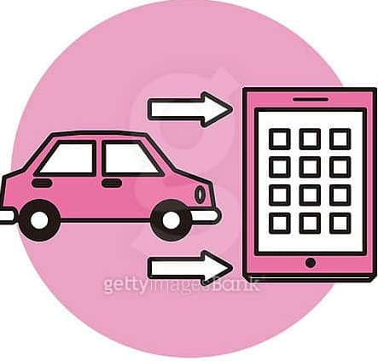
DYNAMIC VEHICLE IDENTIFICATION & TRACKER

Slide 2


TEAM MEMBERS
Jampana Hema Sri - Algorithms and Project management
Prasanna Lakshmi Bandla - Front-End Development
Kasula Pavan Kumar - Backend & Database Development

Slide 3

INTRODUCTION
Dynamic Vehicle Identification is all about developing a system to detect and recognize car license plates from uploaded images, providing secure access and a user-friendly interface.
Its main goal is to offer a secure, user-friendly platform that allows users to easily identify and manage vehicle information.
The intuitive interface enables users to view and manage plate information, making it a reliable solution for vehicle identification and access management.

Slide 4

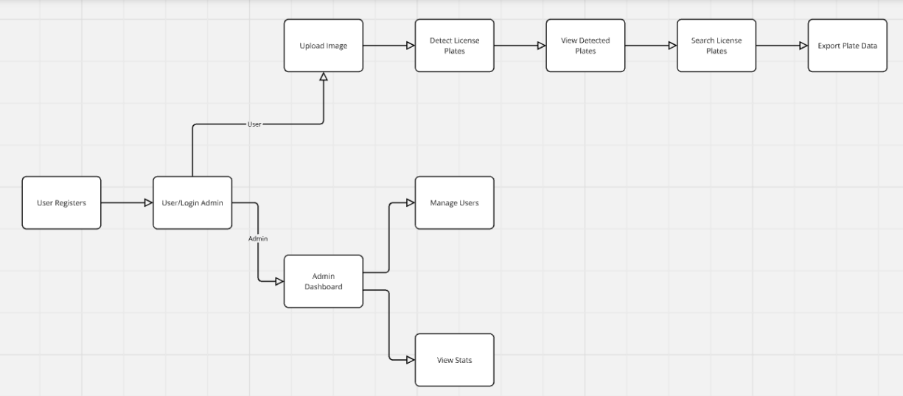
Project Model Design

Slide 5
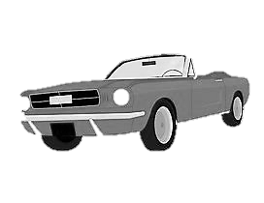
PROJECT OVERVIEW – USER VIEW
SIGN UP: Create a new account to access vehicle identification services.
SIGN IN: Log into your account for a personalized experience.
SERVICES :
Image Upload: Upload images to detect and identify vehicle license
plates.
Video Upload: Upload videos for dynamic vehicle detection and
identification.
Track: View and manage previous vehicle identification searches on
the platform.

Slide 6

PROJECT OVERVIEW – ADMIN VIEW
USER PROFILES : allows the admin to view and manage registered users' details, such as name, email, roles (admin/user), and account status. This feature is useful for monitoring and ensuring proper user management within the system.
SEARCH HISTORY: enables the admin to review users' past activities, such as uploaded images/videos and search records.
ADMIN CONTROLS :
Edit, Add, View and Delete the user’s information and activities.
Login into the application to manage the users.

Slide 7

MILESTONES
02
01
The system leverages image and video processing to automatically detect and recognize vehicle license plates, providing quick and accurate results for both static images and dynamic video footage.
With easy-to-use features like Sign Up, Sign In, and an intuitive interface, users can seamlessly access the vehicle identification services and navigate the platform without hassle.
04
03
The system ensures secure access with controlled authentication, while offering users the ability to view, manage, and export their vehicle identification history, enhancing both security and usability.
Users have access to multiple options—uploading images for plate recognition, analyzing videos for moving vehicle detection, and tracking their previous searches—all within a single platform.

Slide 8
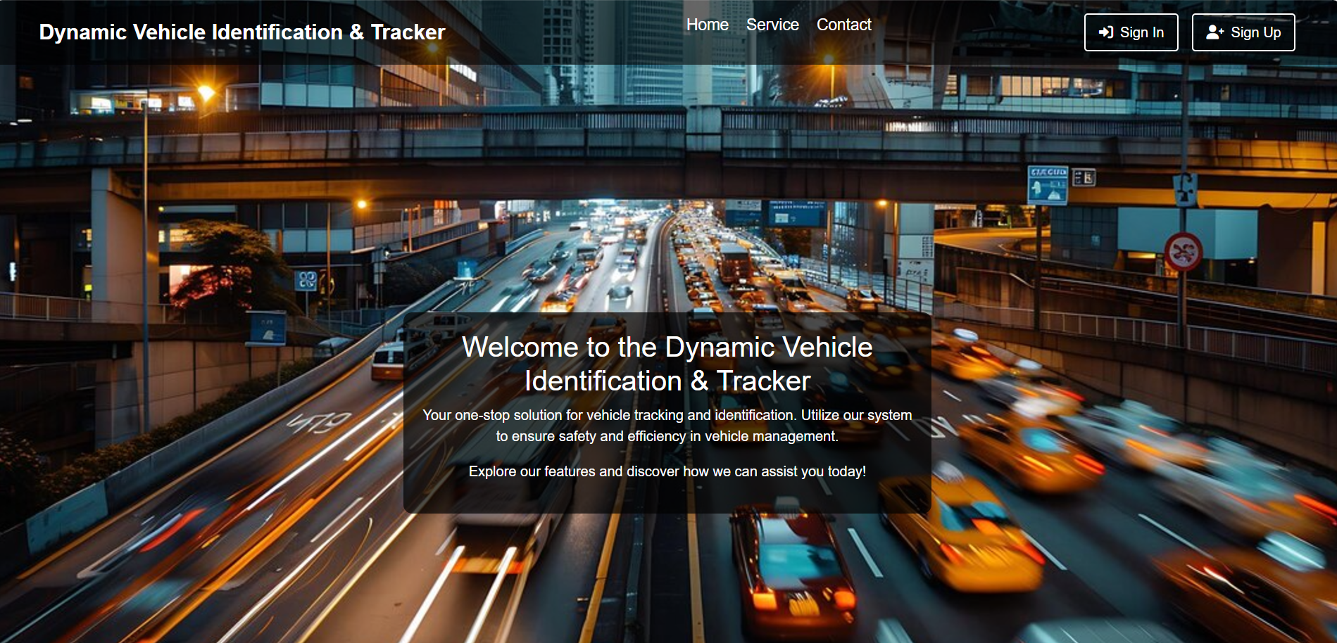
HOME PAGE

Slide 9
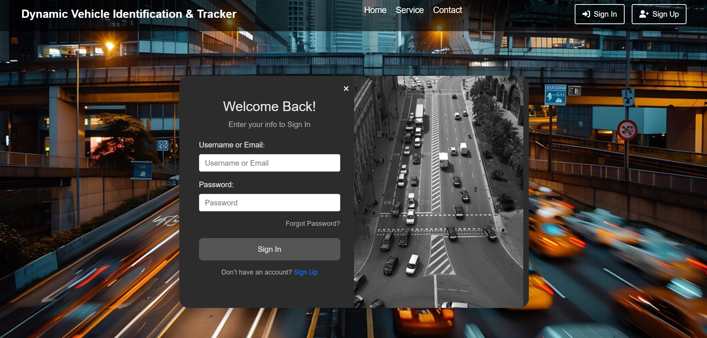
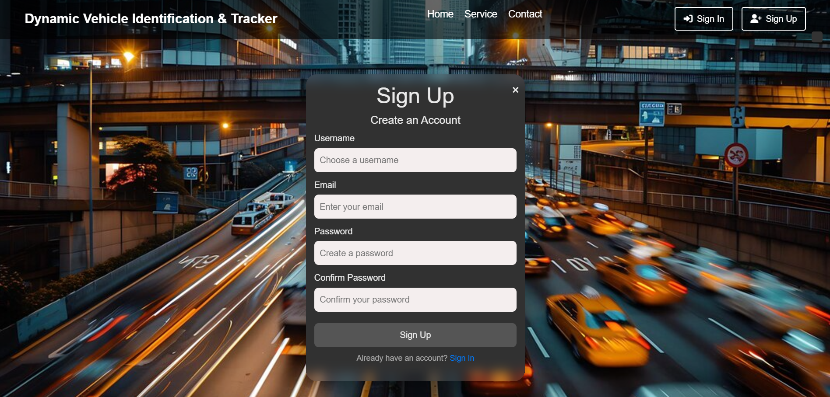
SIGN IN / SIGN UP PAGES

Slide 10
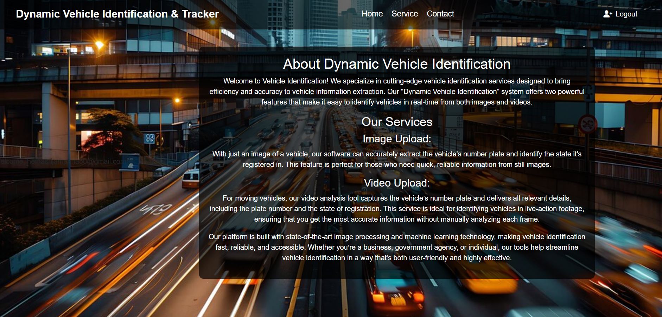
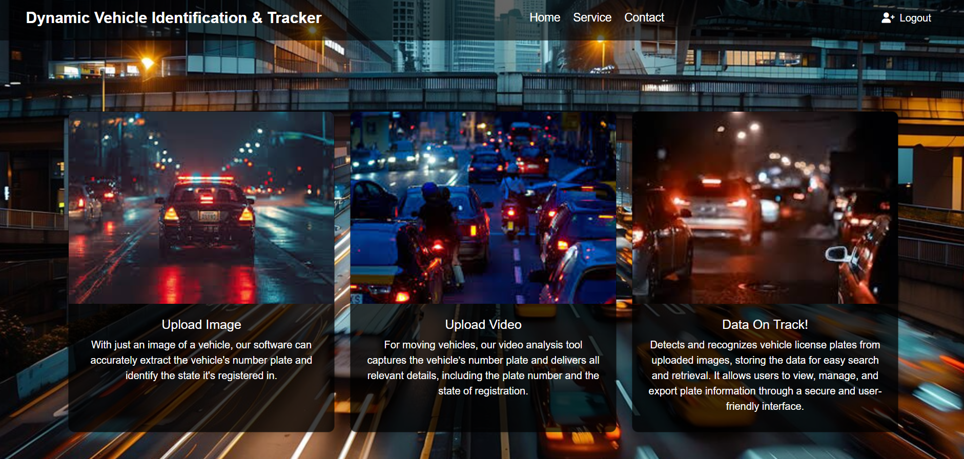
HOME / SERVICE PAGES

Slide 11
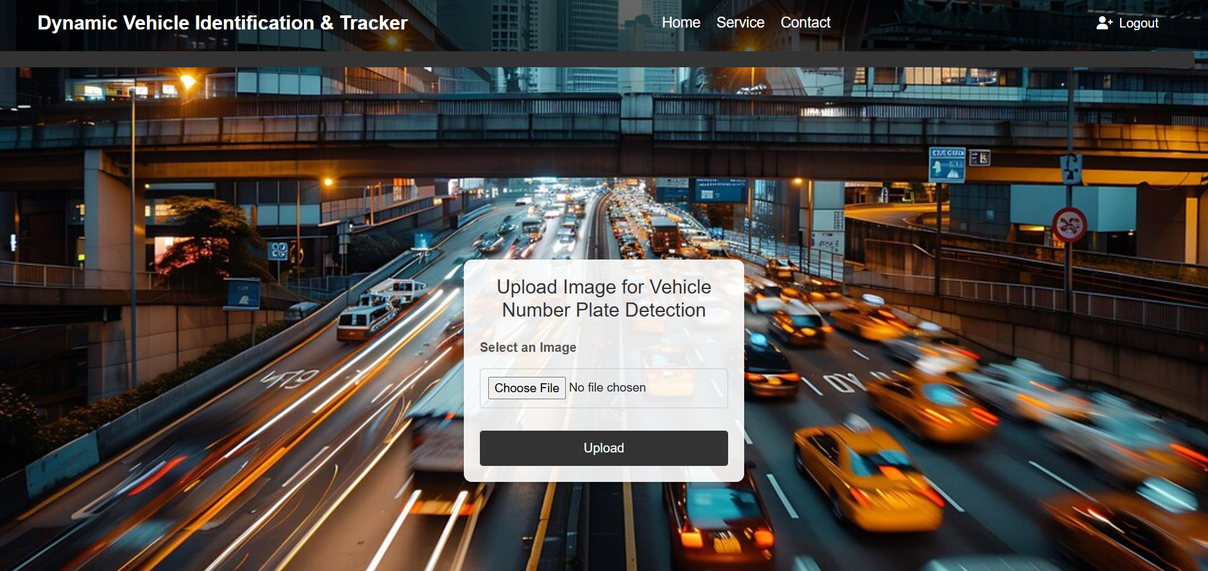
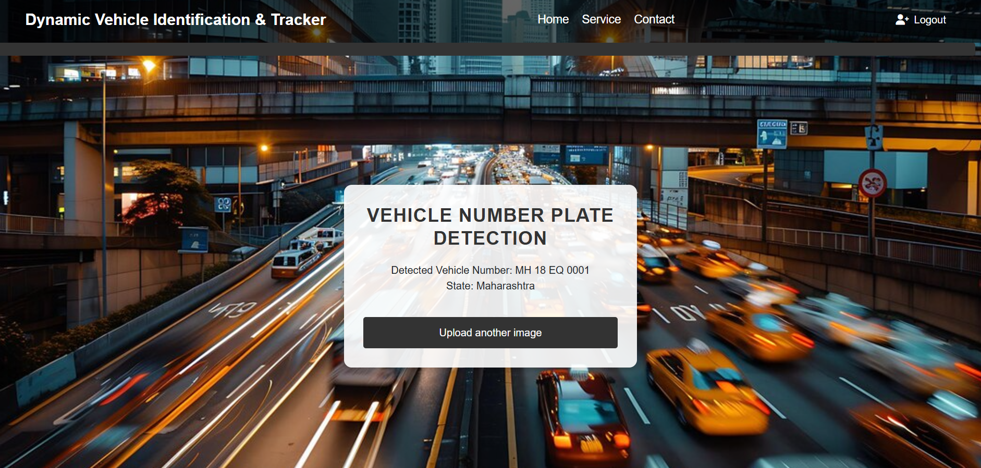
IMAGE UPLOAD & RESULT PAGES

Slide 12

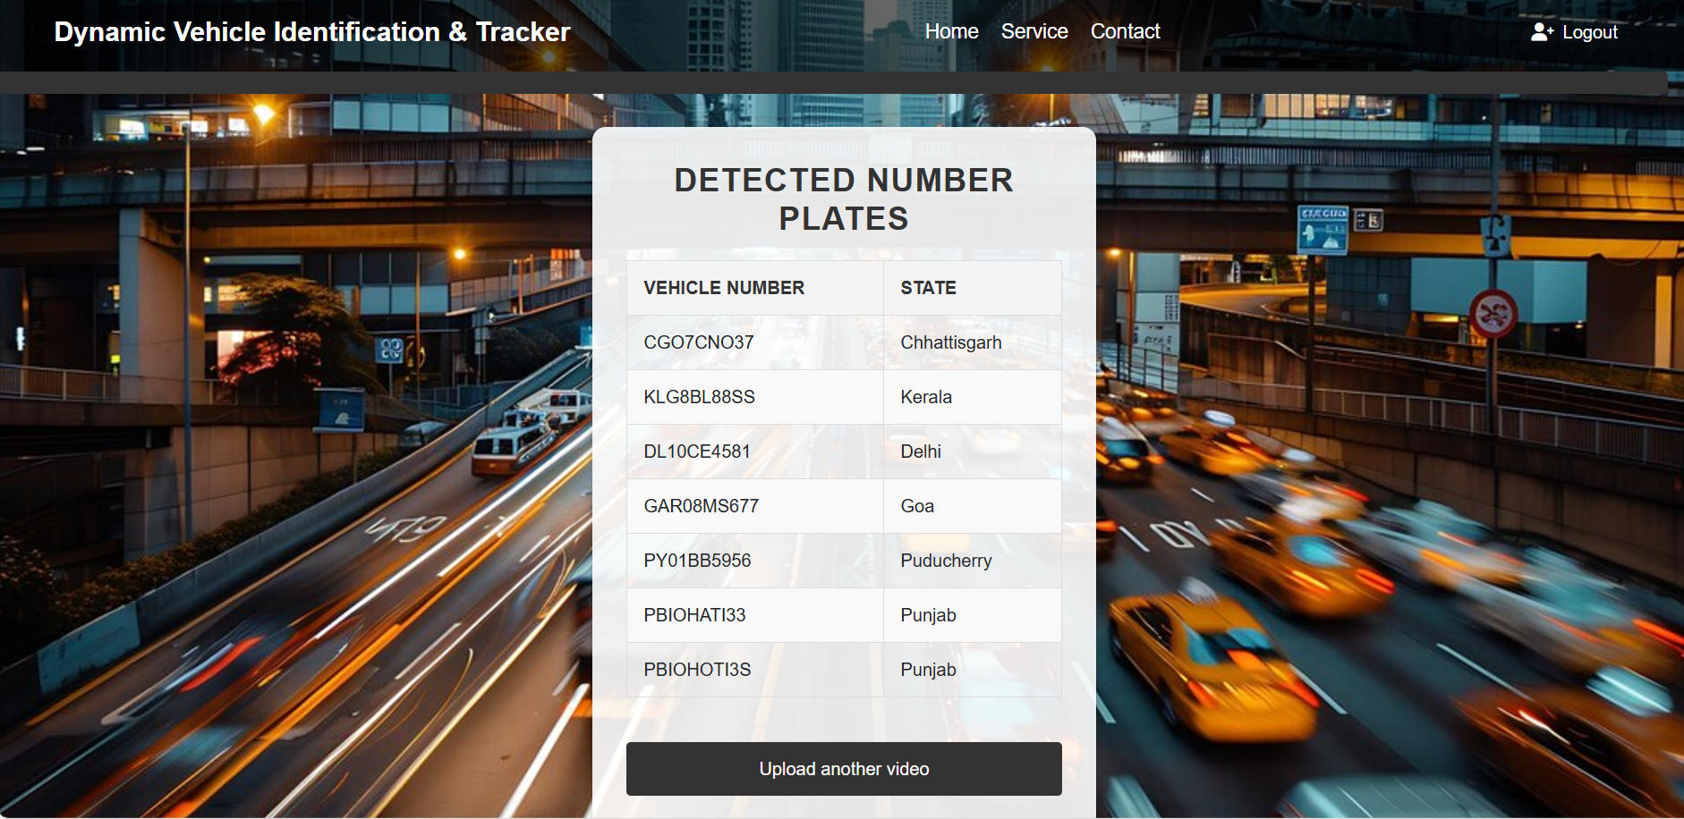
VIDEO UPLOAD & RESULT PAGES

Slide 13
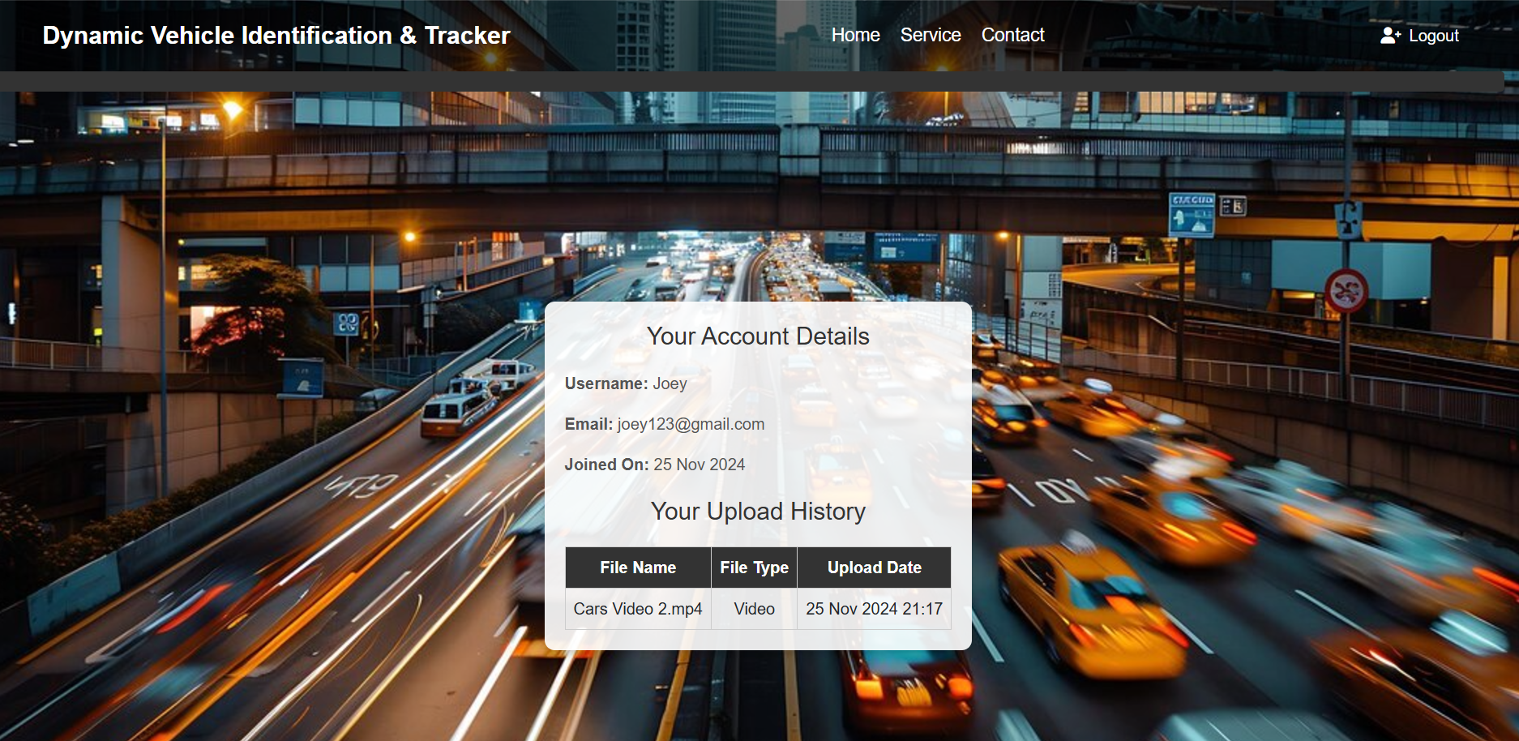
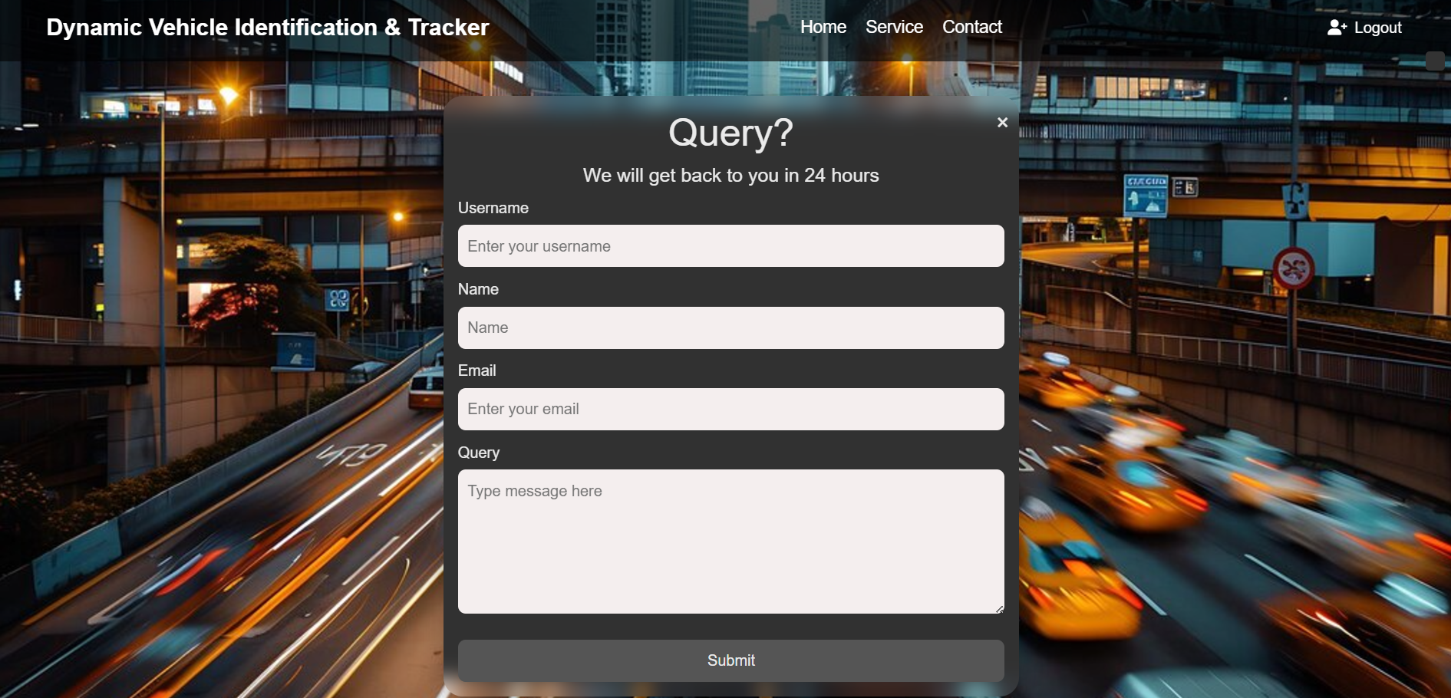
ACCOUNT DETAILS & CONTACT PAGES

Slide 14
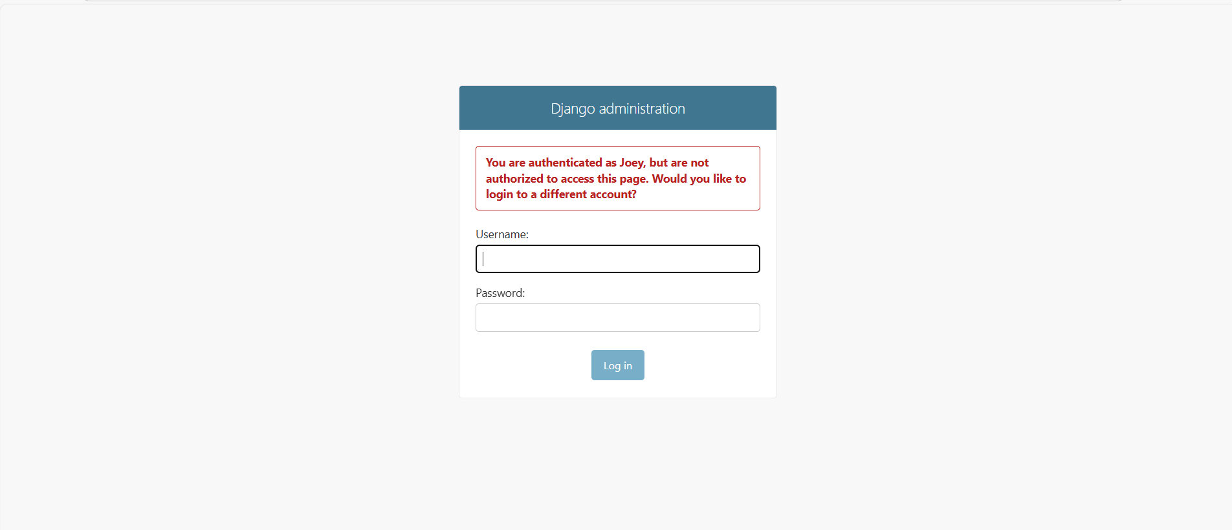
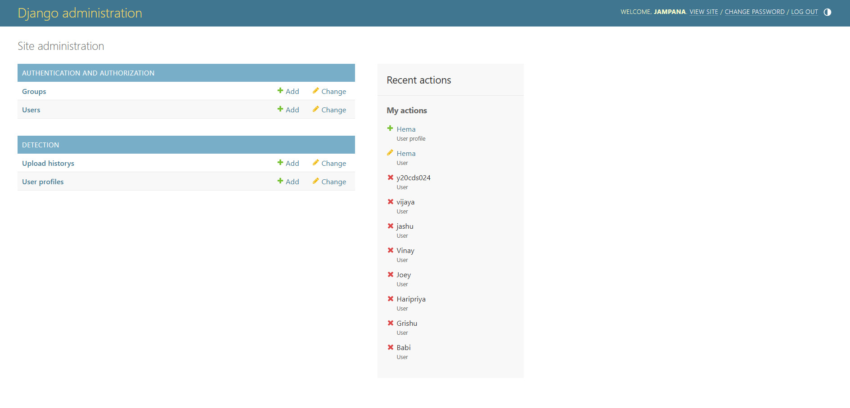
ADMIN PAGE

Slide 15
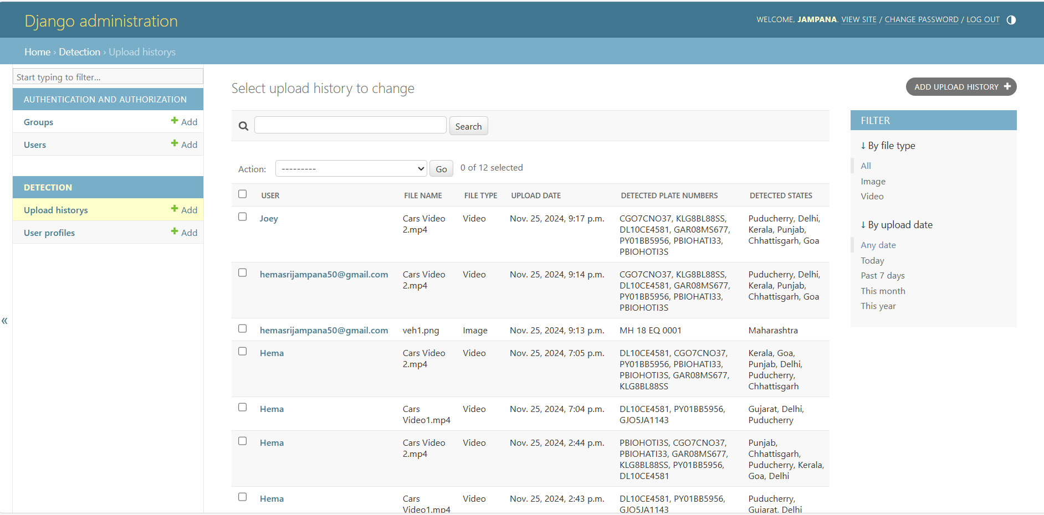
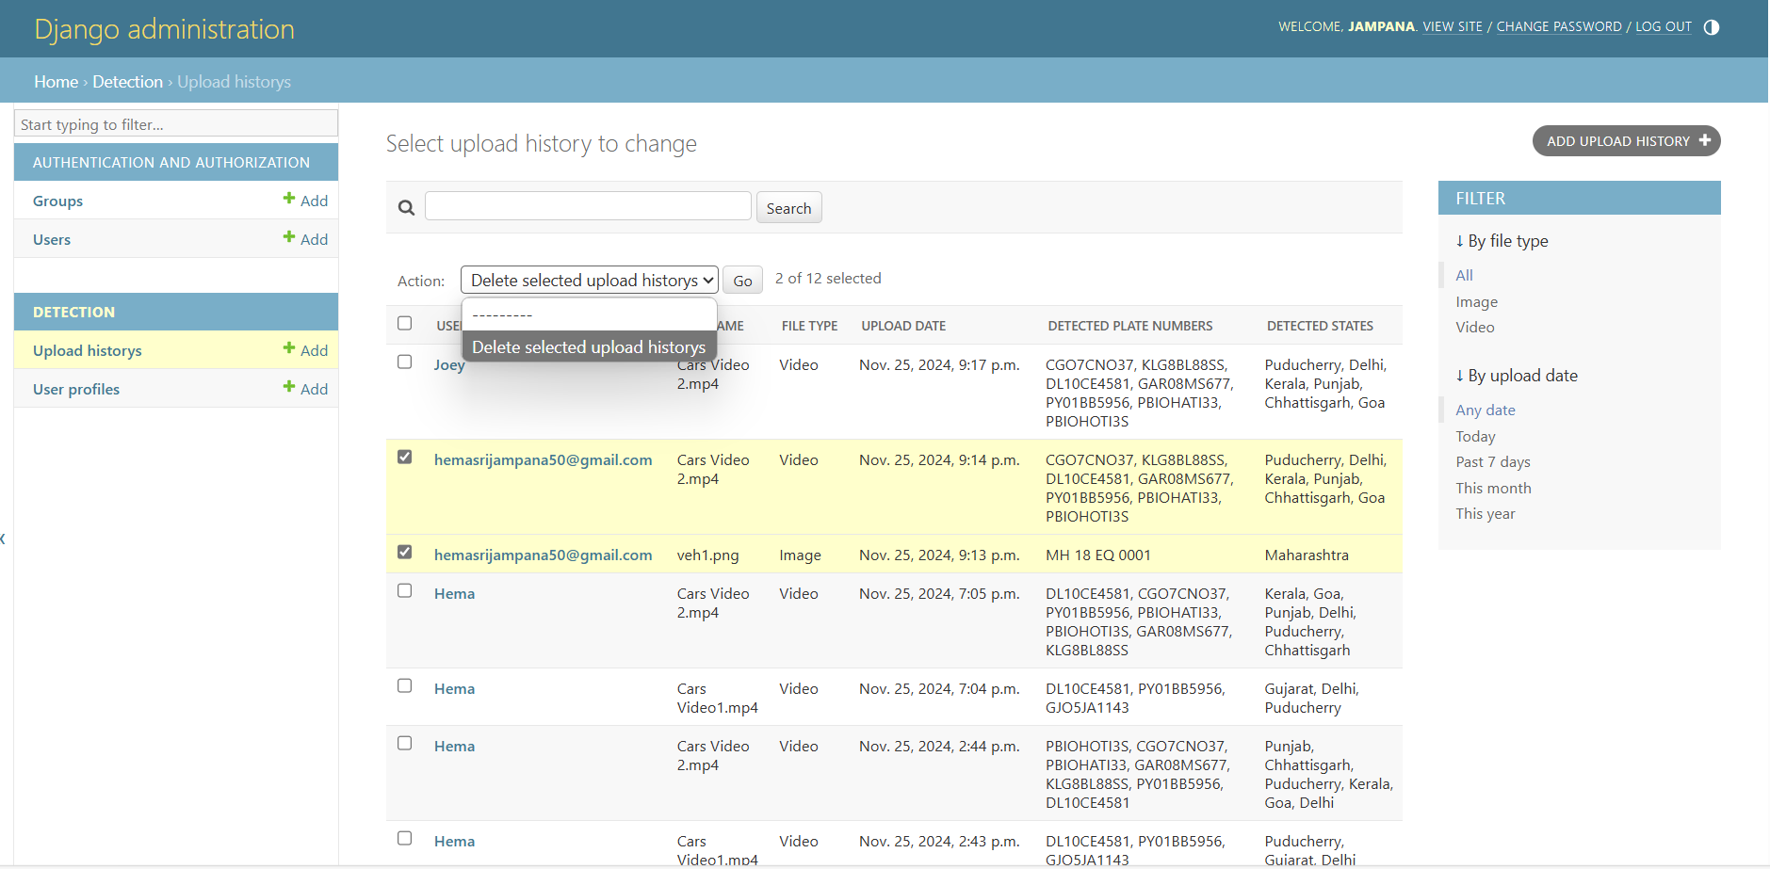
ADMIN CONTROLS

Slide 16
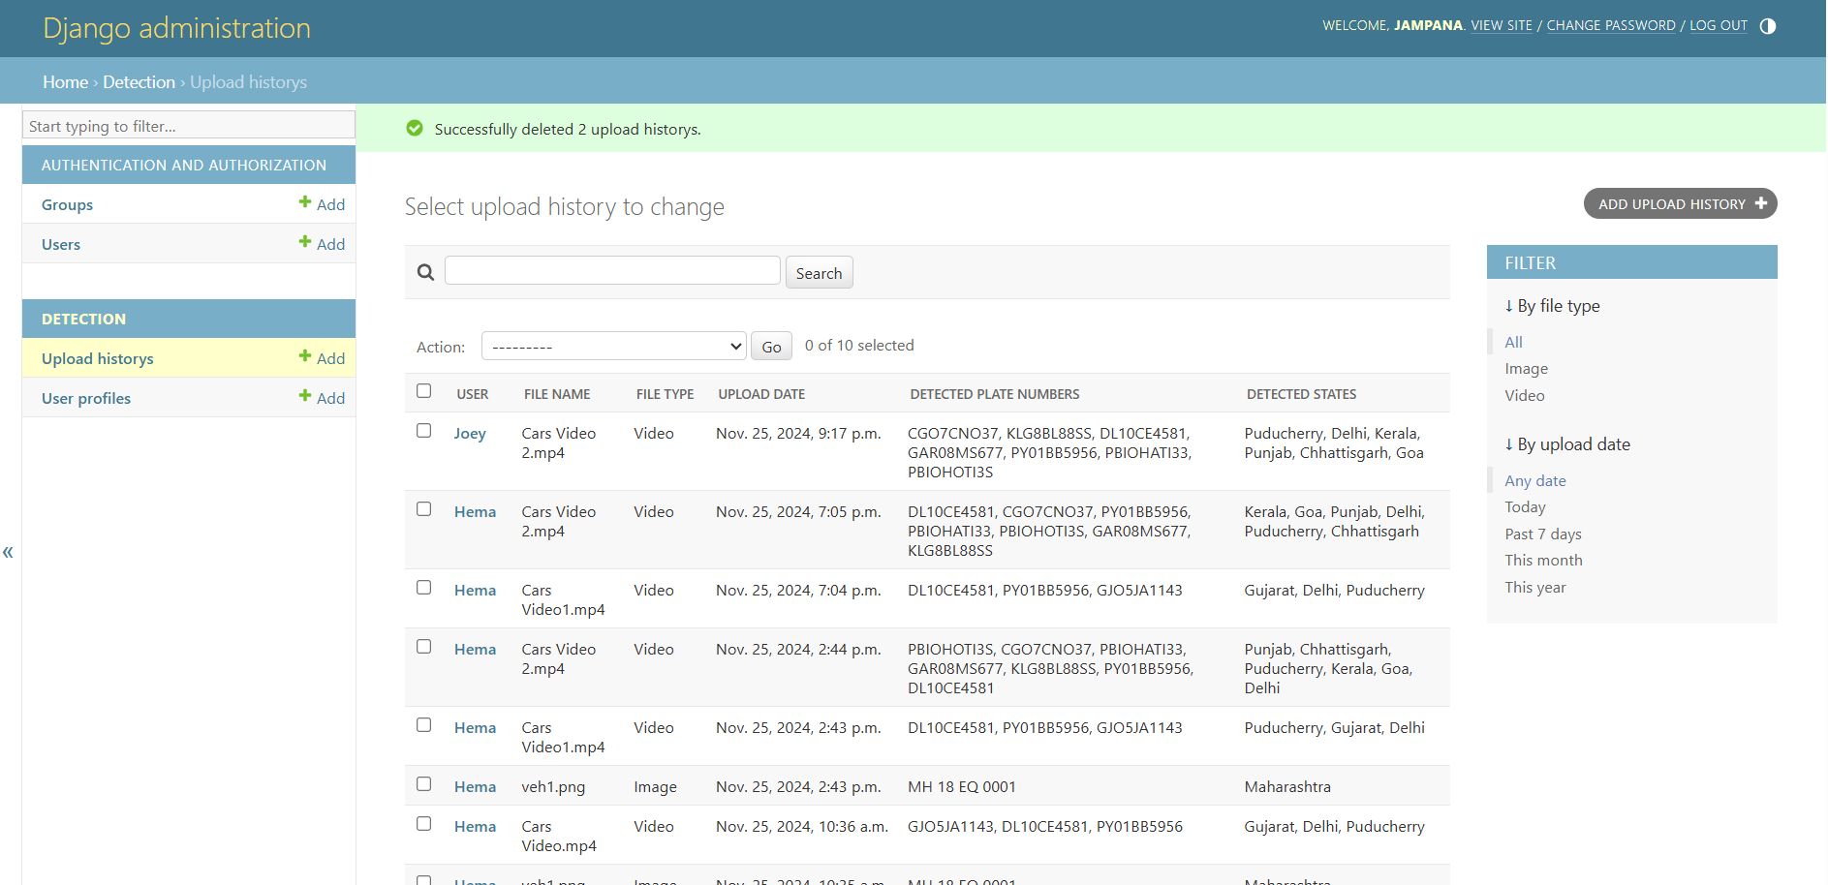
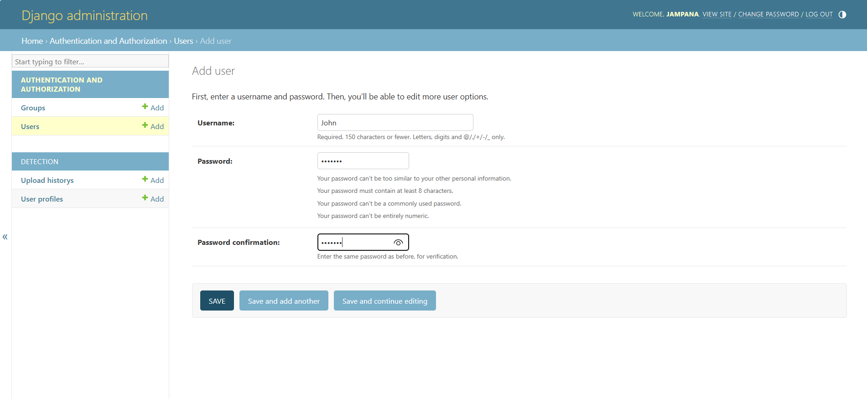
ADMIN CONTROLS

Slide 17
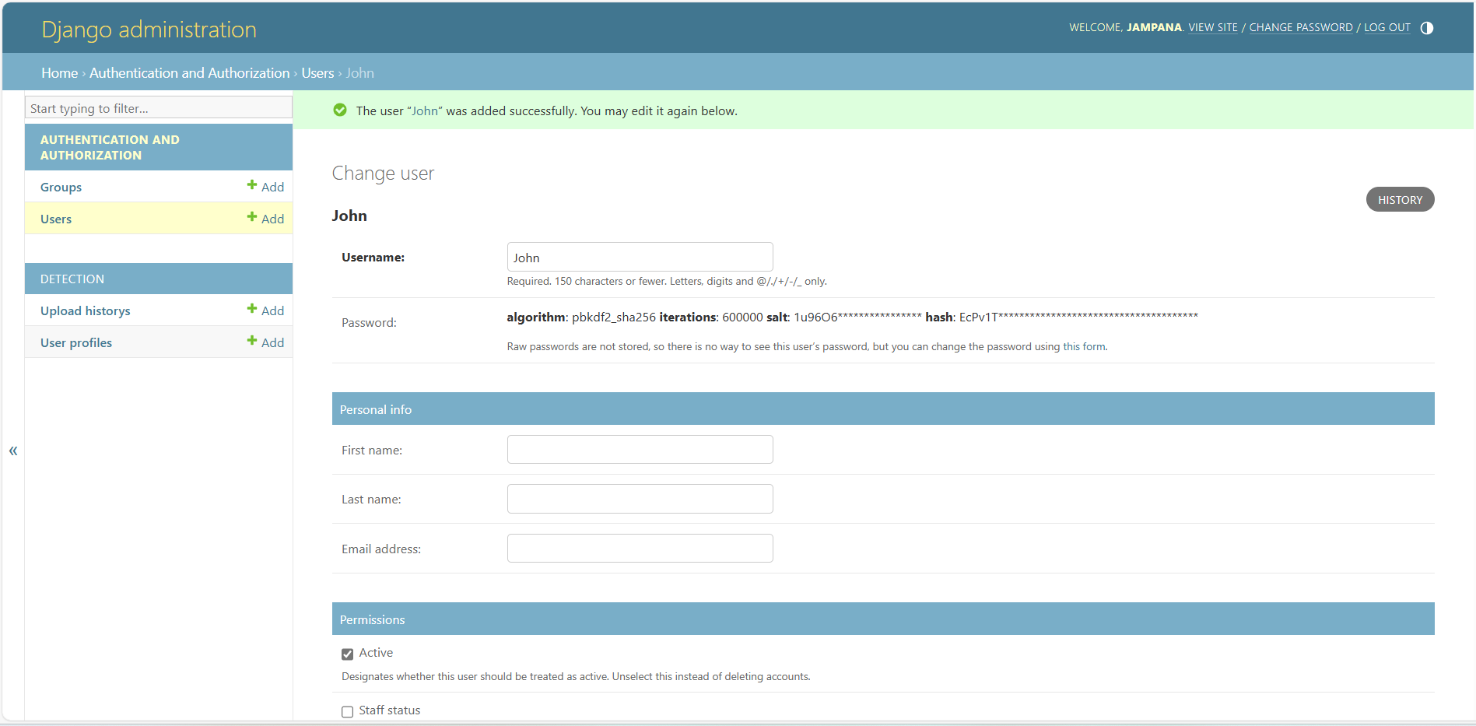
ADMIN CONTROLS

Slide 18

FEATURE ADVANCEMENTS
ROLE-BASED ACCESS ENHANCEMENTS
Expand user roles (e.g., moderators) for better access management.
STATISTICS FOR USERS AND SYSTEM USAGE
Tracking usage statistics can provide valuable insights into the system’s performance and user engagement.
DETECTION SETUP
To detect district and state information from the license plates, you’ll need a mapping of license plate numbers to specific geographic locations.

Slide 19

The Dynamic Vehicle Identification and Tracker project is a critical feature that ensures secure and streamlined access to the system.
It provides user authentication, redirecting admins and regular users to their respective sections for effective role management. The design emphasizes security, usability, and aesthetics, making it both functional and user-friendly.

Slide 20



